Slide 1
Assignment 3
Your name: Peng, Chen
Your GTID: 903646937

Slide 2
Visualization

Slide 3
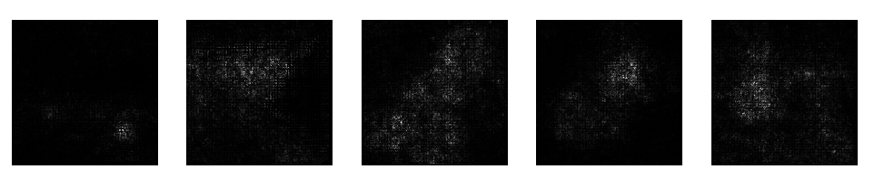
Saliency Map
Include your saliency map here

Slide 4
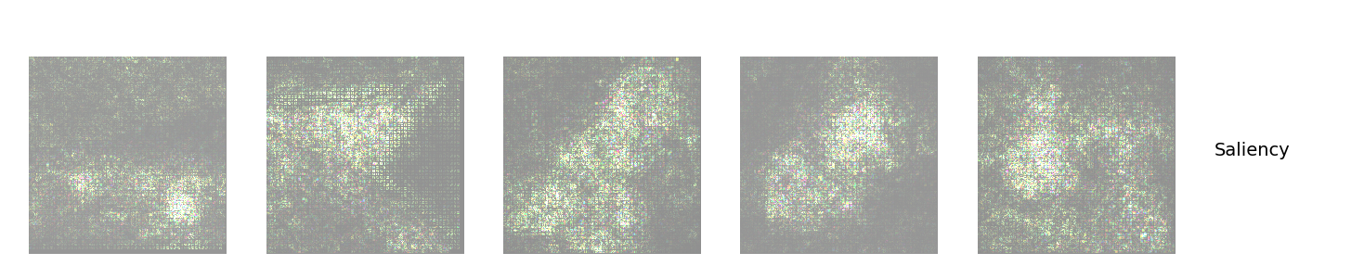
Saliency Map
Include your saliency map from Captum here

Slide 5
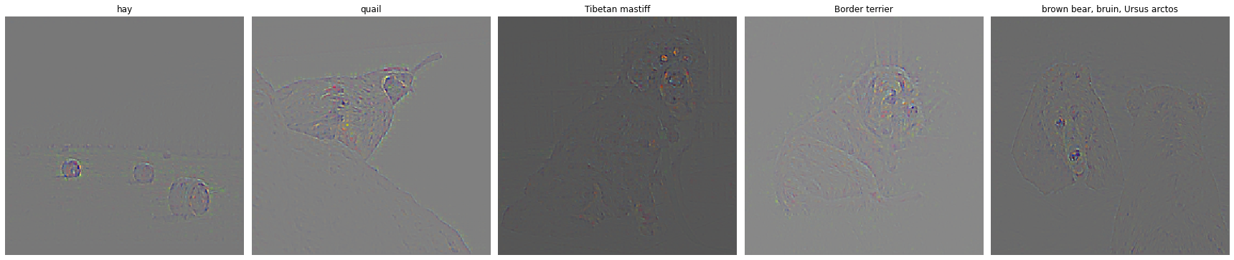
GradCam
Include your visualization of Guided Backprop here

Slide 6
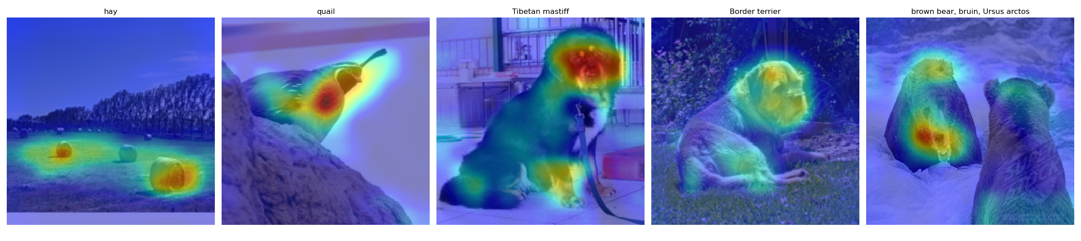
GradCam
Include your visualization of GradCam here

Slide 7
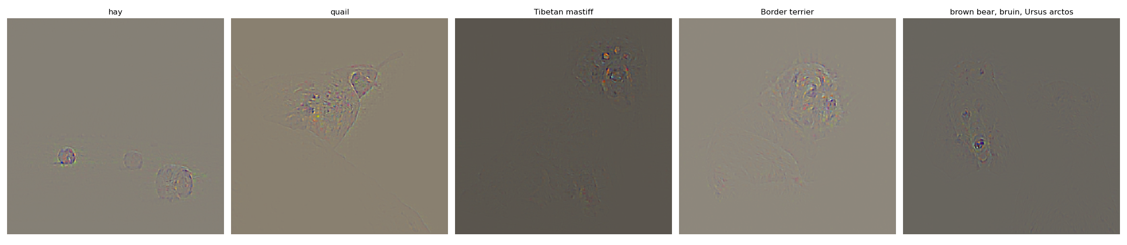
GradCam
Include your visualization of Guided GradCam here

Slide 8
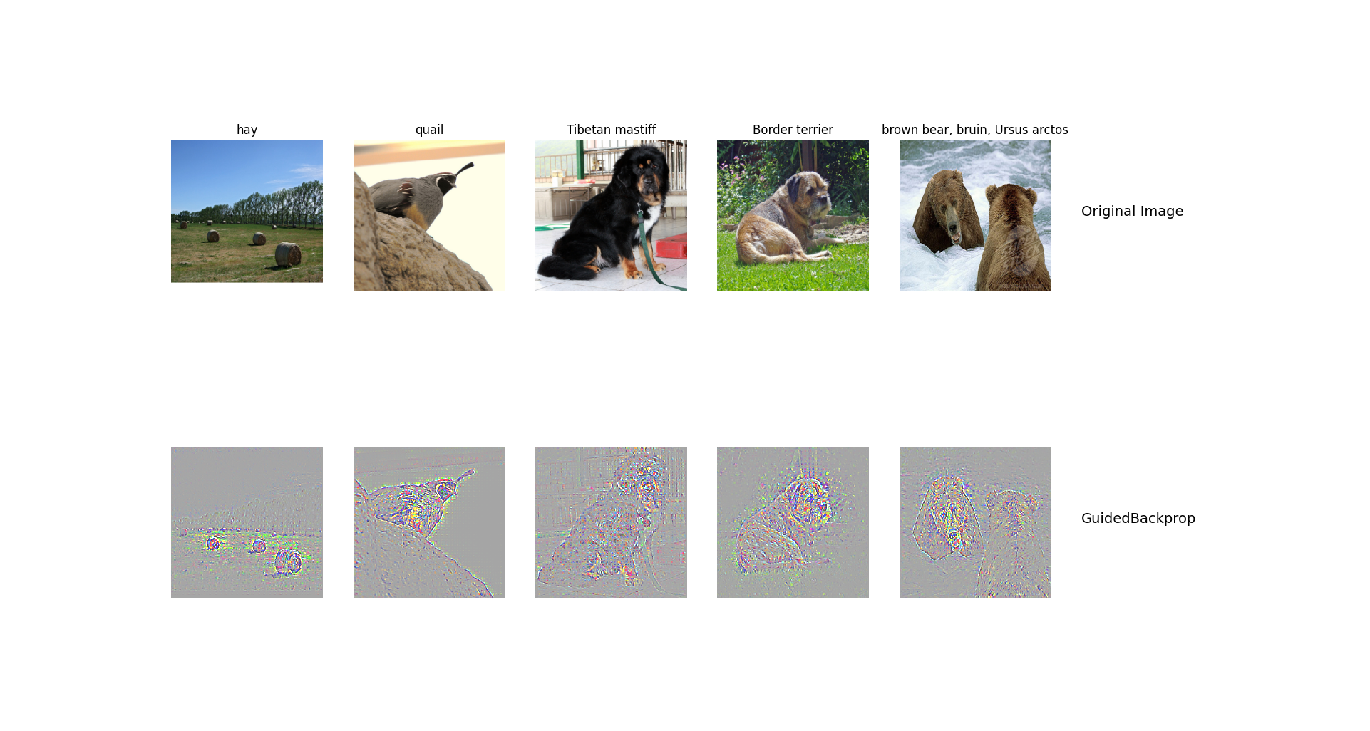

GradCam
Include your visualization of Guided Backprop and Guided Gradcam from Captum here

Slide 9
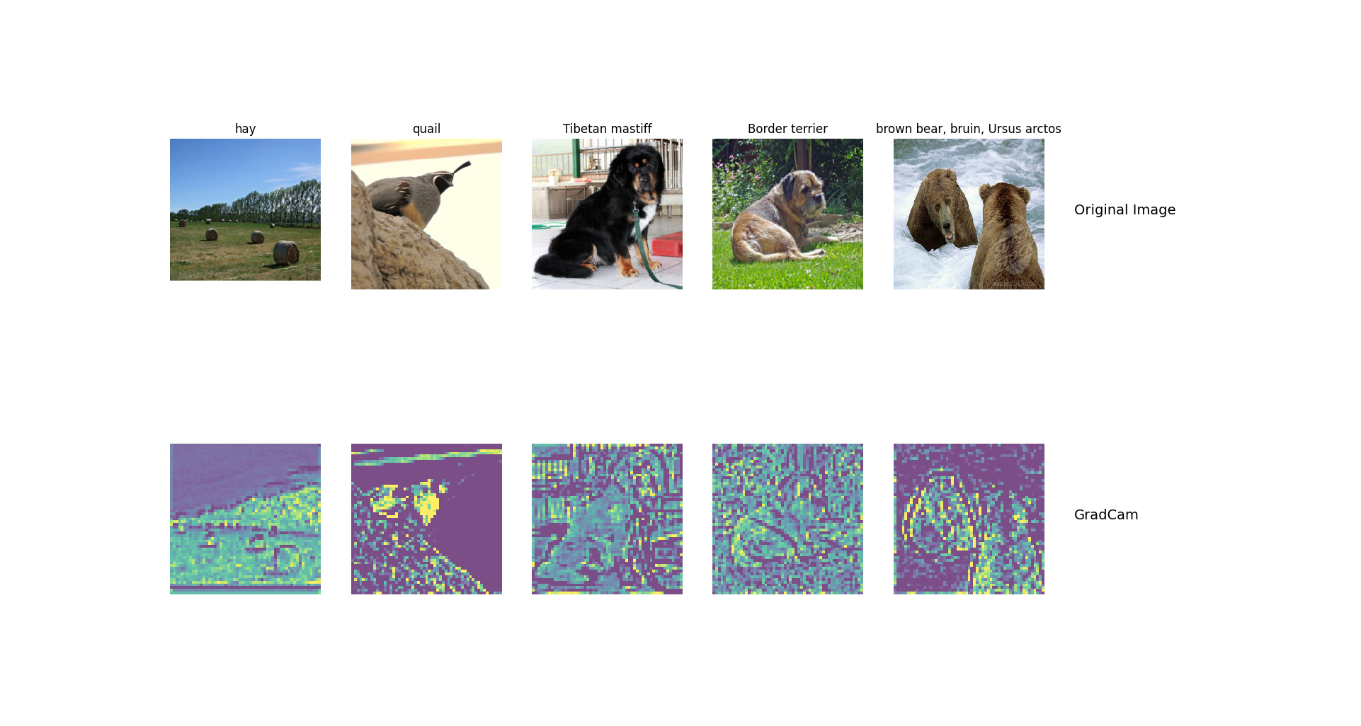
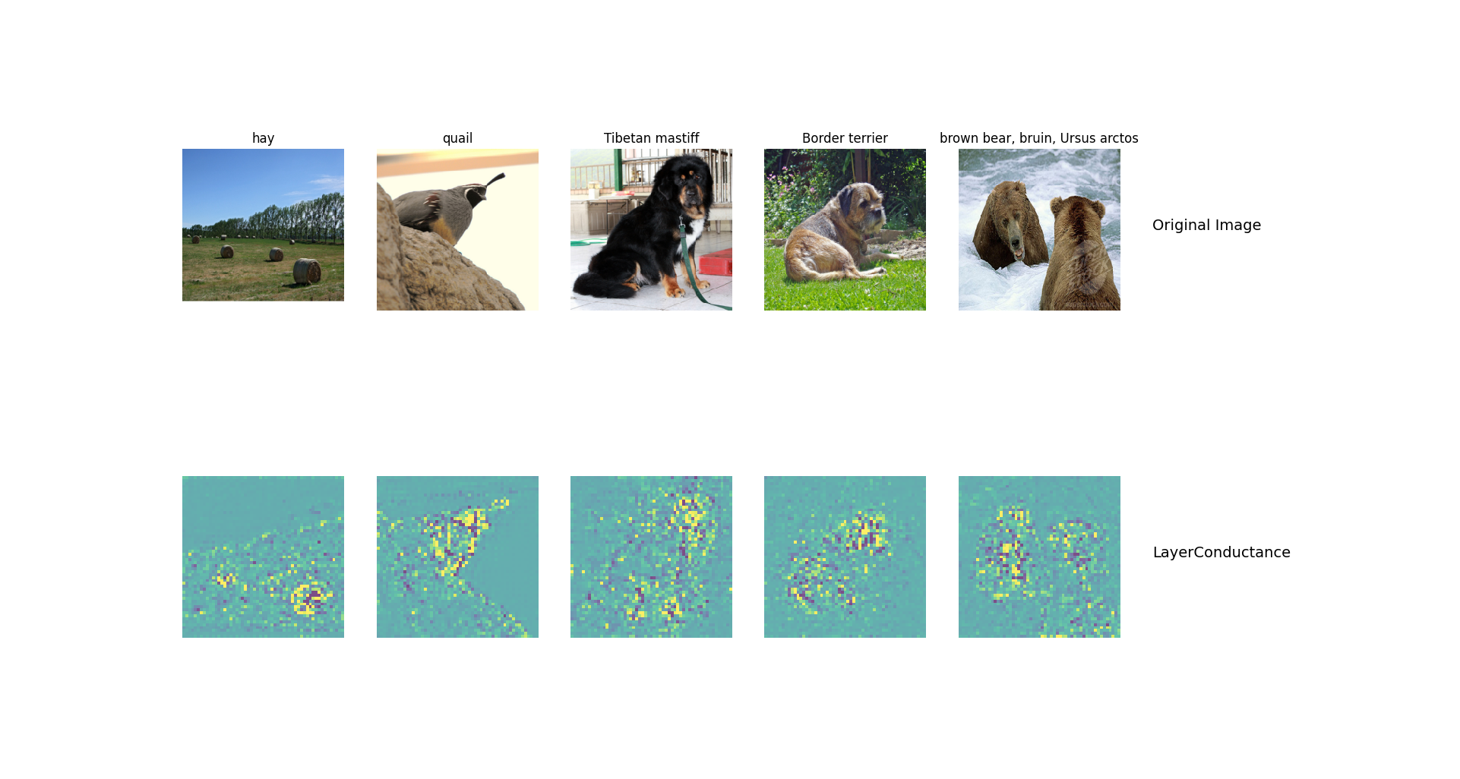
GradCam
Visualization of layers and neurons using Captum here:
LayerGradCam

Slide 10
What do saliency map and Gradcam tell you
Answer: Saliency map calculate the impact of each point on the prediction category. The higher the brightness of the area, the greater the impact of this pixel on the prediction result.
Grad-CAM uses the gradient of any target concept (such as the logits of a certain category in the classification category, or even the output in the caption task), flows into the final convolutional layer, and generates a rough positioning map to highlight the use of the image Important areas for forecasting.
There techniques are very helpful for understanding the working principle of neural network. In the process of iterative training of the model, such a visualization method can also show the model's decision-making method to a certain extent.

Slide 11
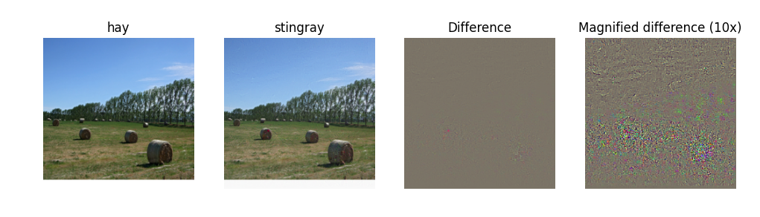
Fooling Image
Include the fooling image here

Slide 12
Fooling Image
What insights do you get from fooling images:
The fooling image adjusts the picture to make it fool the trained network, with iteratively update the input picture with the gradient of the target classification to the input picture.
The features catched by the network are very different from humans. After we understand which pixels have a greater impact on the prediction results, by adding some noise that is difficult for humans to detect, it can significantly interfere with the prediction results.
We can use the fooling image to train the network and make the results more stable.

Slide 13
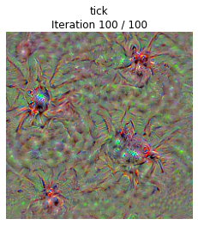
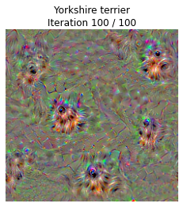
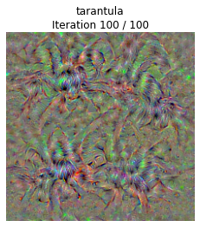
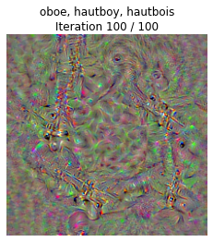
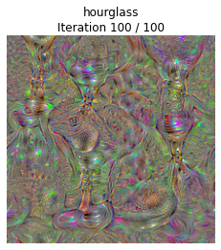
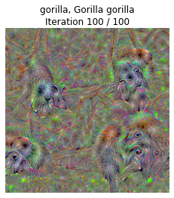
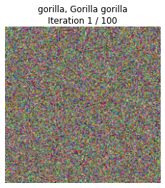
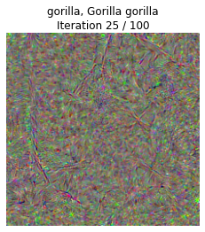
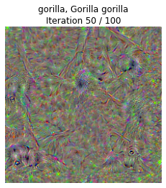
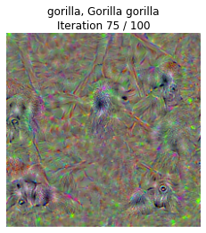
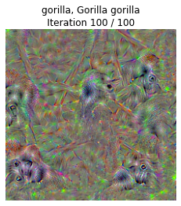
Class Visualization
Include class visualization of Gorilla here

Slide 14
Style Transfer

Slide 15
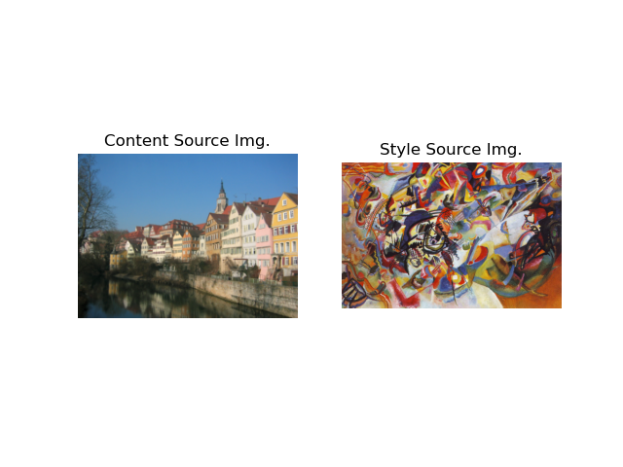
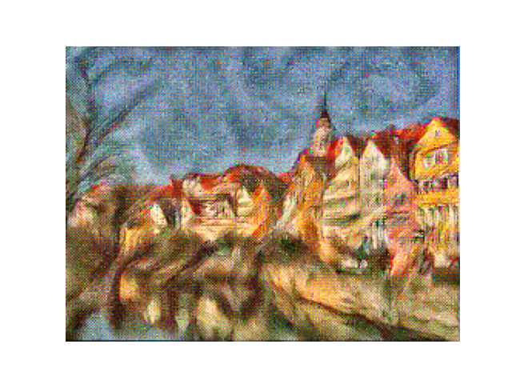
Composition VII + Tubingen
Include both original images and the transferred image

Slide 16
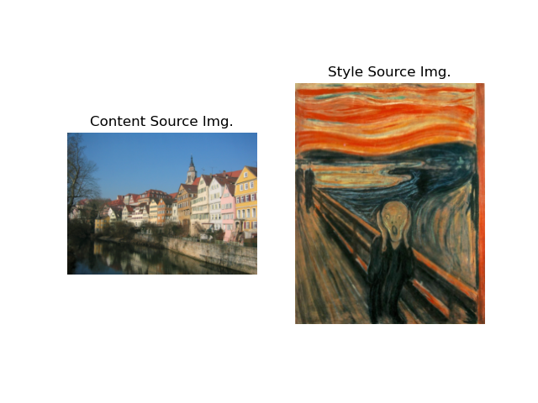
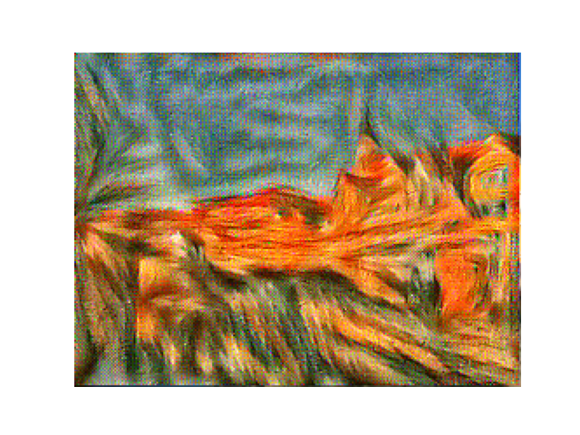
Scream + Tubingen
Include both original images and the transferred image

Slide 17
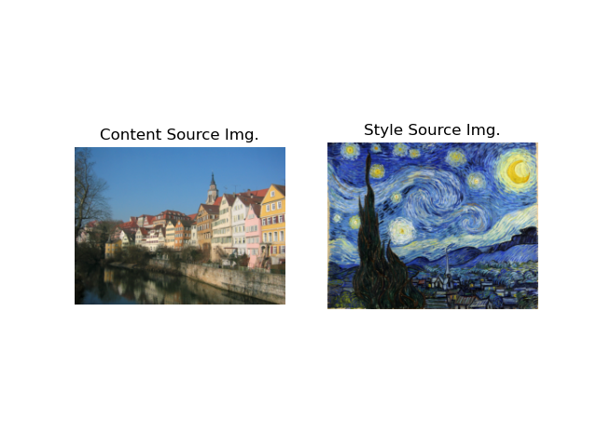
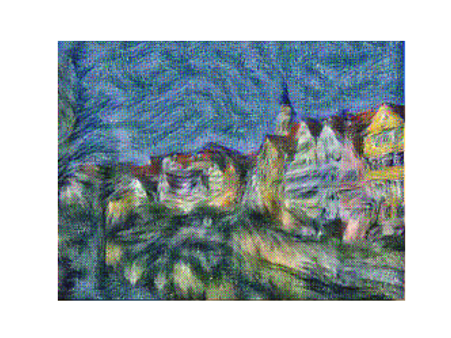
Starry Night + Tubingen
Include both original images and the transferred image

